Slide 1
Parallel Computing
Yanci Zhang

Slide 2
Outline
Motivation
Basic concepts
GPU overview
OpenMP

Slide 3
Outline
Motivation
Basic concepts
GPU overview
OpenMP

Slide 4
Golden Age for Programmer
Performance of CPU increased 50% per year from 1986 to 2002
Clock rate of CPU: historical milestones
IBM PC, 1981, 4.77 MHz
Intel 30386, 1985, 16 MHz
Intel 80486, 1989, 25 MHz
Intel Pentium, 1995, 100 MHz
Intel Pentium 4, 2002, 3 GHz
AMD FX 4170, 2011, 4.3 GHz
Simply wait for next generation of CPU to obtain increased performance

Slide 5
Why CPU Frequency Stalled?
Single-processor performance improvement slowed down to 20% since 2002
CPU frequency stalled because
No longer worth the cost in terms of power consumed and heat dissipated
Almost reach physical limit
An electric signal needs 1 nanosecond to travel a distance of about 30 cm, close to the distances a signal travels in computer
For CPU running at 4 GHz, one clock cycle is about 23 nanosecond

Slide 6
Multi-core Swerve
Road to rapidly increasing performance lay in the direction of parallelism
Put multiple processors on a single circuit rather than developing ever-faster monolithic processor
Need new computation model to fully exploit the power of new hardware
Parallel computing on CPU and GPU

Slide 7

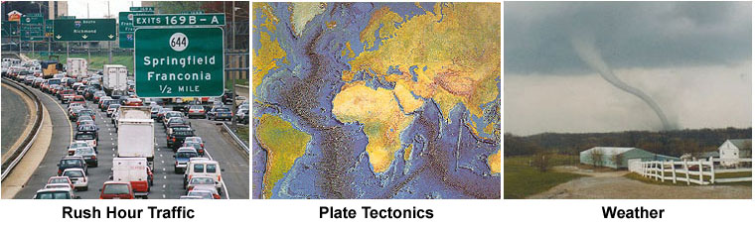
Why Parallel Computing? 1/4
From applications perspective, we need parallel computing
Real world is massively parallel

Slide 8

Why Parallel Computing? 2/4
Save time and/or money
Throwing more resources at a task will shorten its time to completion, with potential cost savings

Slide 9

Why Parallel Computing? 3/4
Solve larger problems
Many problems are so large/complex
Impractical or impossible to solve them on a single computer, especially given limited computer memory

Slide 10

Why Parallel Computing? 4/4
Use of non-local resources
Using compute resources on a wide area network, or even the Internet when local compute resources are scarce
Cloud computing, grid computing…

Slide 11

What is Parallel Computing
Parallel computing is simultaneous use of multiple compute resources to solve a computational problem
Problem is broken into discrete parts to be solved concurrently
Instructions from each part execute simultaneously on different processors
An overall control/coordination mechanism is employed

Slide 12

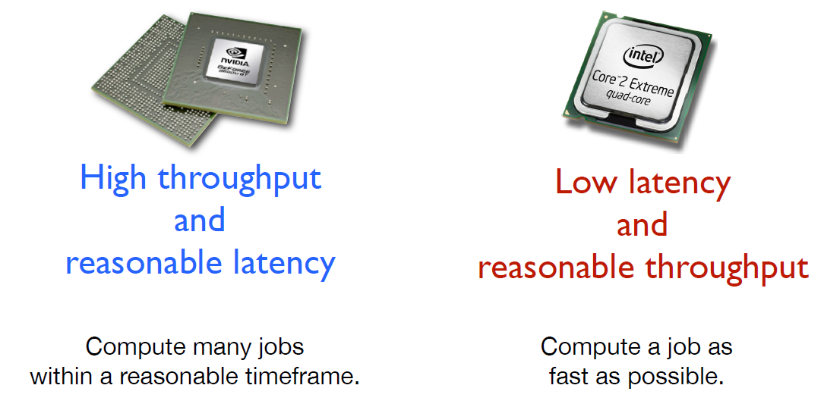
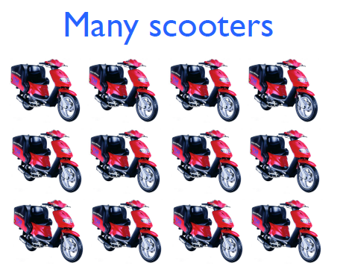
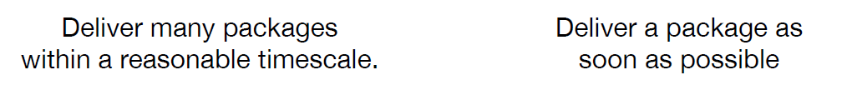
What is Parallel Computing
Which is better?

Slide 13
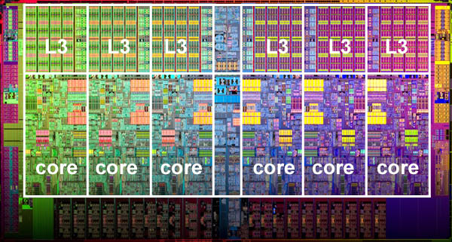
Parallel Computers 1/2
Virtually all stand-alone computers today are parallel from a hardware perspective:
Multiple functional units
Multiple execution units/cores
Multiple hardware threads

Slide 14
Parallel Computers 2/2
Networks connect multiple stand-alone computers to make larger parallel computer clusters
Majority of large parallel computers are clusters of hardware produced by handful of well-known vendors
TOP500 supercomputers are mostly based on x86-64 CPUs, with few exceptions (all RISC-based)
Heterogeneous computing has become a popular way to reach better performance/watt ratio and higher absolute performance
Mostly using Nvidia's GPU as coprocessors

Slide 15
Outline
Motivation
Basic concepts
GPU overview
OpenMP

Slide 16
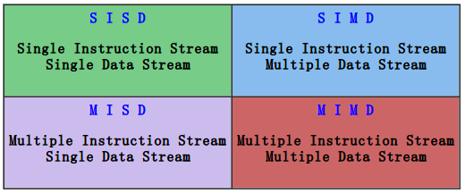
Flynn's Classical Taxonomy
Most widely used classifications for parallel computers
Distinguishes multi-processor computer architectures along two independent dimensions of Instruction Stream and Data Stream
Each of these dimensions can have only one of two possible states: Single or Multiple

Slide 17
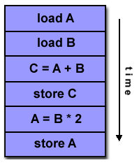
SISD
A serial (non-parallel) computer, oldest type of computer
Single Instruction: Only one instruction stream is being acted on by the CPU during any one clock cycle
Single Data: Only one data stream is being used as input during any one clock cycle
Deterministic execution

Slide 18
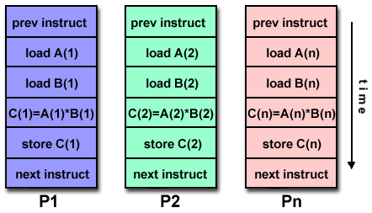
SIMD
SIMD
Single Instruction: All processing units execute the same instruction at any given clock cycle
Multiple Data: Each processing unit can operate on a different data element
Best suited for graphics and image processing
Synchronous, deterministic execution

Slide 19
Amdahl's Law 1/3
Potential program speedup defined by the fraction of code (P) that can be parallelized
Example: If 50% of code can be parallelized, maximum speedup = 2, meaning the code will run twice as fast ideally

Slide 20
Amdahl's Law 2/3
If considering # of processors N performing parallel fraction of work, the relationship can be modeled by:

Slide 21
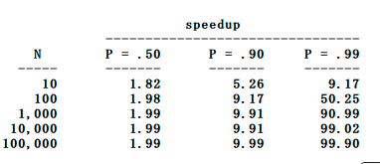
Amdahl's Law 3/3
There are limits to scalability of parallelism
Increasing fraction of code can be parallelized is better than using more processors

Slide 22
Parallelization of Program
The most common tool is parallelizing compiler
Works in two different way
Fully automatic
Compiler analyzes source code and identifies opportunities for parallelism
Loops are the most frequent target for automatic parallelization
Programmer directed
Using "compiler directives" explicitly tells compiler how to parallelize code

Slide 23
Automatic Parallelization
Good options for beginner but with following disadvantages
Wrong results may be produced
Performance may actually degrade
Much less flexible than manual parallelization
Limited to a subset (mostly loops) of code
May actually not parallelize code if analysis suggests there are inhibitors or the code is too complex

Slide 24
Designing Parallel Program
Fundamental issue: break problem into discrete "chunks" of work that can be distributed to multiple tasks
Domain decomposition
Functional decomposition

Slide 25
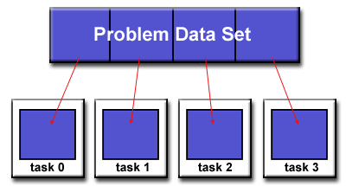
Domain Decomposition
Decompose data associated with a problem
Each parallel task then works on a portion of data

Slide 26
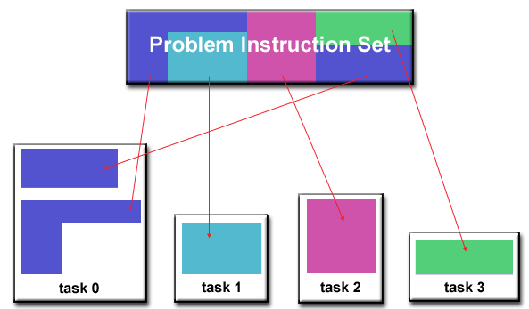
Functional Decomposition
Focus on computation performed rather than on data manipulated by computation
Problem is decomposed according to work to be done. Each task performs a portion of overall work

Slide 27
Using Parallel Computing
Both CPU & GPU are multi-core architecture
GPU
OpenGL/DirectX Shading language
CUDA
OpenCL
…
CPU
General multi-threaded programming
OpenMP
MPI
…

Slide 28
Outline
Motivation
Basic concepts
GPU overview
OpenMP

Slide 29
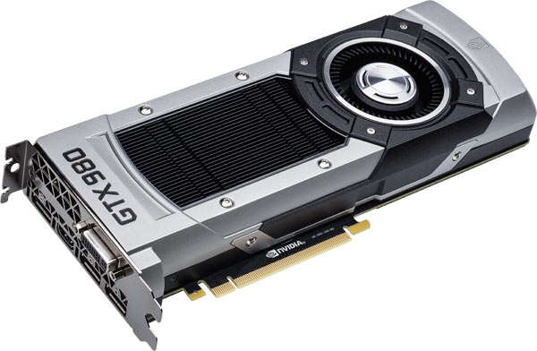
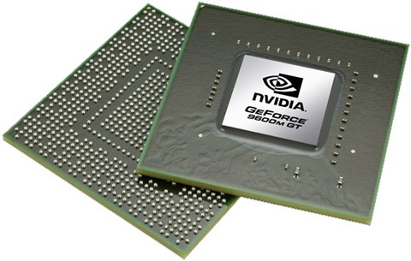
What is GPU
GPU: Graphics Processor Unit

Slide 30

Motivation 1/2
Demo: GPU vs. CPU

Slide 31
Motivation 2/2
GPU is more powerful than CPU
Computational power
Number of computing cores
Bandwidth
High performance growth

Slide 32
Floating Point Calculation
Heavy use of floating point calculation
FLOPS: Floating point Operations Per Second
CPU
Intel Xeon E5-2600: 149.16 GFLOPS
GPU
nVidia GeForce GTX Titan Z: 8.1/2.7 TFLOPS(single/double precision)
Modern GPUs support high precision
32-bit floating point throughout the pipeline
Support double precision

Slide 33
Number of Cores
CPU
Dual-core, quad-core, six-core
Hyper-threading
Improves parallelization of computations performed on Intel’s x86 microprocessors
For each physical core, OS addresses two virtual or logical cores, and shares workload between them when possible
GPU
GeForce GTX Titan Z: equipped with 5760 cores

Slide 34
Bandwidth
Bandwidth between key components ultimately dictates system performance
CPU
DDR3-2666: 31.6GB/s
GPU
GeForce GTX Titan Z: 384x2 bits, 672GB/s

Slide 35
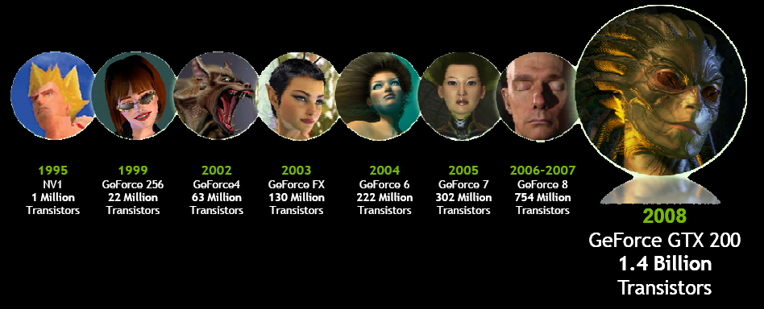
Getting Faster and Faster
CPU
Annual growth ~ 1.5x -> decade growth ~60x
GPU
Annual growth ~2.0x -> decade growth > 1000x
Much faster than Moore’s law
Multi-billion dollar video game market is a pressure cooker that drives innovation

Slide 36
Evolution of GPU
Developed rapidly from being primitive drawing devices to being major computing resources
Original function: 3D rendering
From fixed graphics pipeline to programmable graphics pipeline
GPGPU: General Purpose computation on GPU
CUDA, OpenCL

Slide 37


GPU Computing
Architecture of GPU is redesigned so that GPU can be directly used in solving general problems
New software APIs are proposed to manage GPU computing
CUDA: Compute Unified Device Architecture
OpenCL: Open Computing Language

Slide 38
Outline
Motivation
Basic concepts
GPU overview
OpenMP

Slide 39
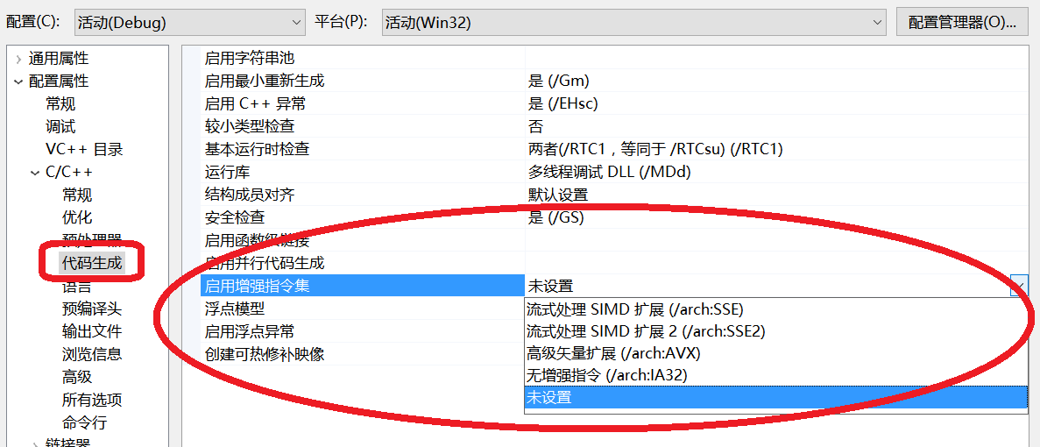
Parallel Computing on CPU 1/2
On instruction level
Intel provides Streaming SIMD Extensions (Intel® SSE), Intel® Advanced Vector Extensions (Intel® AVX)

Slide 40
Parallel Computing on CPU 2/2
On programming language level
Native threading methods of OS are directly available for programmers (e.g. Windows* threads)
Offer low level interface for full control but without benefits of high level programming abstractions
Avoiding direct use of threading models has been a strong trend
None of the most popular programming languages were designed for parallel programming
Extensions for pre-existing languages (C, C++, Fortran)
OpenMP
Intel Threading Building Blocks
MPI

Slide 41
What is OpenMP?
High-level API for multi-threaded shared memory programs
Three primary API components
Compiler Directives
Runtime Library Routines
Environment Variables

Slide 42
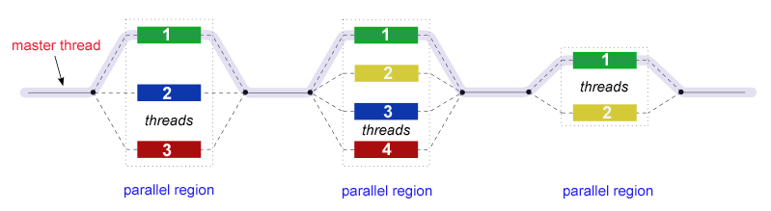
OpenMP Programming Model 1/2
Fork-Join model
Begin as a single process executing sequentially until first parallel region construct is encountered
FORK: master thread creates multiple team threads automatically
Statements enclosed by the parallel region construct are executed in parallel among various team threads
JOIN: When team threads complete, they synchronize and terminate, leaving only the master thread

Slide 43
OpenMP Programming Model 2/2
Compiler directive based
Most OpenMP parallelism is specified through compiler directives
Nested parallelism
Dynamic threads
Ability to dynamically alter number of threads executing parallel regions
I/O
Specifies nothing about parallel I/O
Up to programmer to ensure correctness of I/O operations within context of multi-threaded program

Slide 44
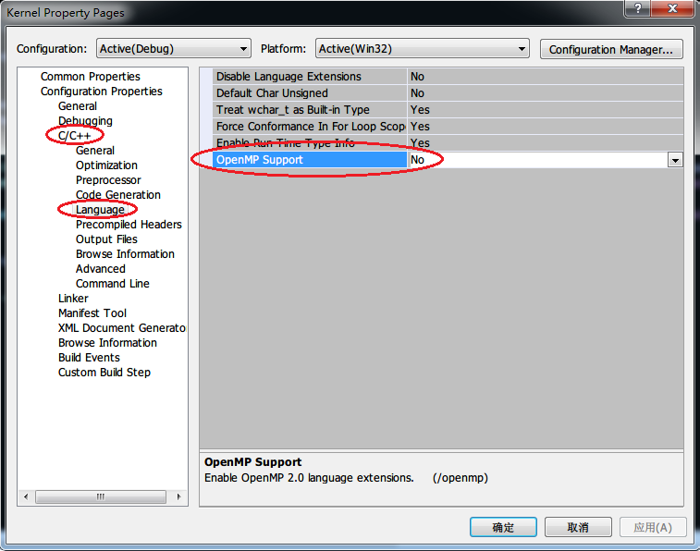
Configure OpenMP
Supported by Microsoft Visual Studio
#include <omp.h>
Configure compile options

Slide 45
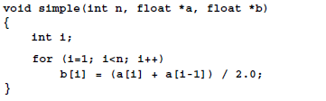
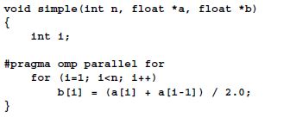
First Example 1/2
Serial program
OpenMP program

Slide 46
First Example 2/2
Key line
OpenMP automatically handles threads creation and deletion
OpenMP automatically conducts data decomposition
Example:
Suppose that OpenMP starts 4 threads to execute FOR loop
OpenMP automatically divides data to four parts [1, n/4], [n/4, n/2], [n/2, 3n/4], [3n/4, n], which are handled by 4 threads respectively

Slide 47

Dijkstra Shortest Path Algorithm
The Problem: Given a graph with non-negative edge weights G=(V, E) and a distinguished source vertex, $s∈V$, determine distance and shortest path from s to every vertex in graph

Slide 48
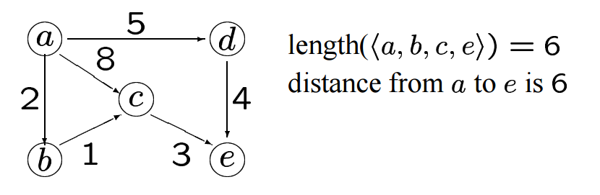
Important Observation
Any subpath of a shortest path mush also be a shortest path
Example: <a,b,c,e> is a shortest path. The subpath <a,b,c> is a also a shortest path

Slide 49
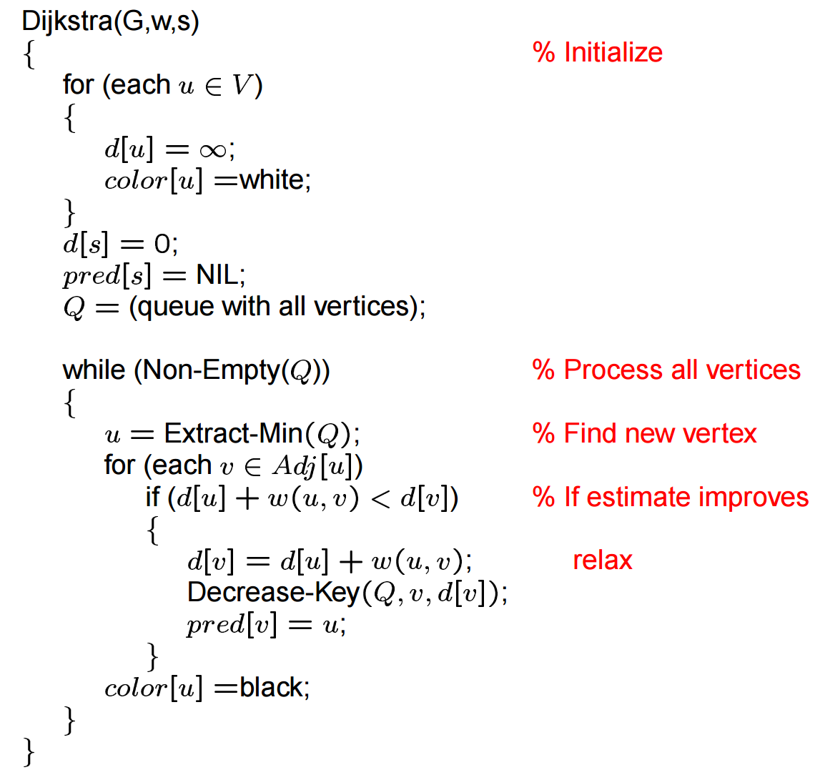
Pseudo Code

Slide 50
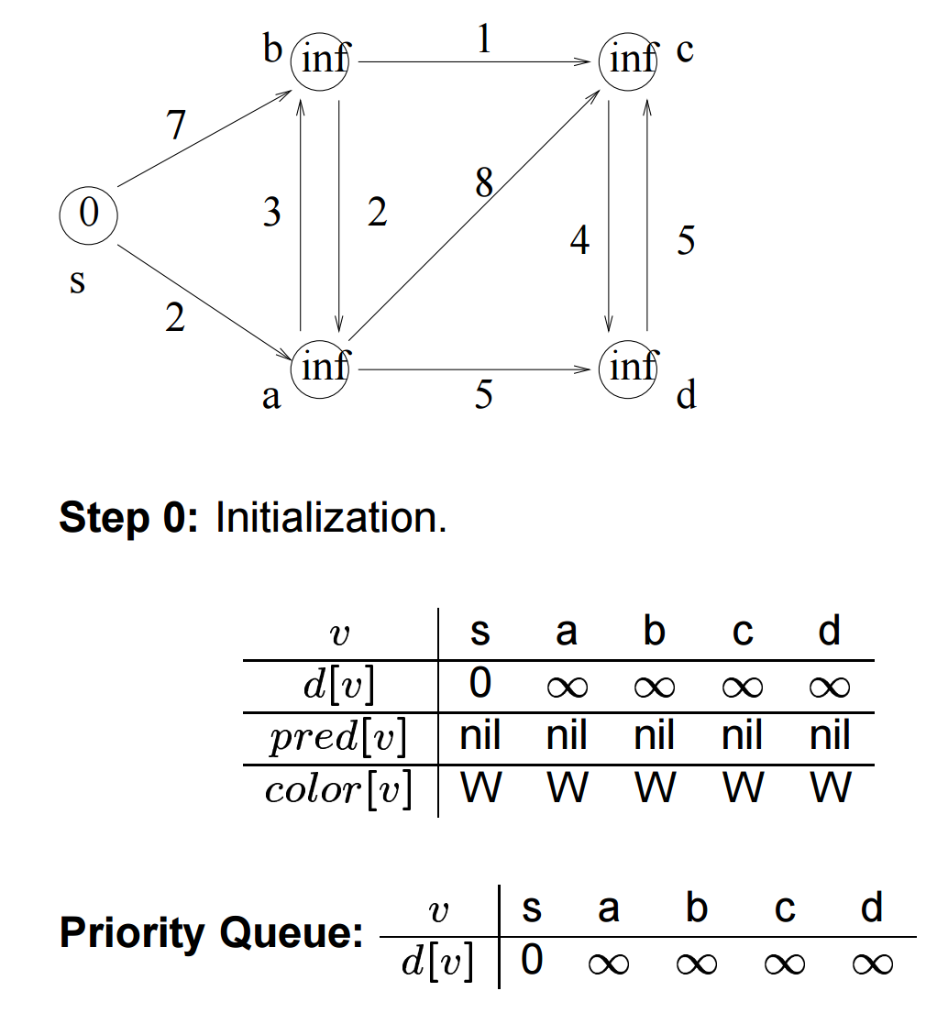
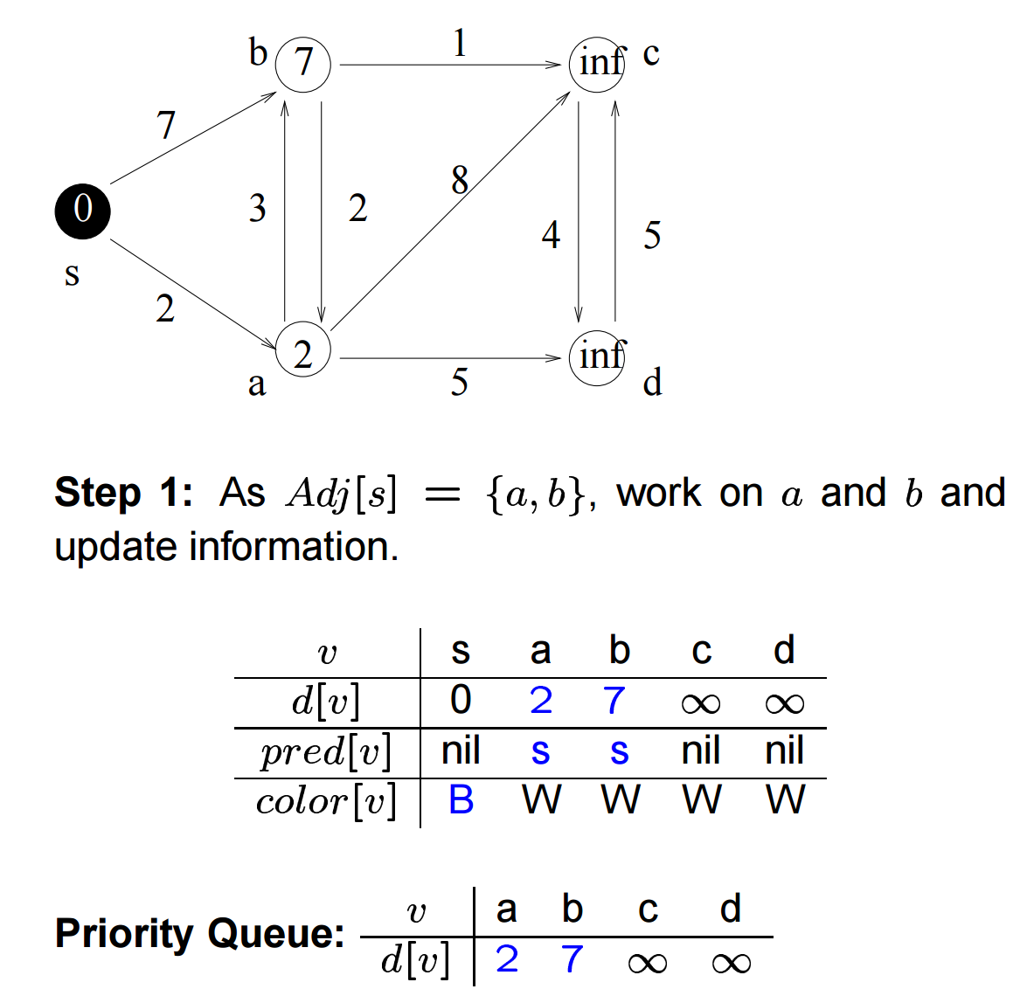
Example 1/3

Slide 51
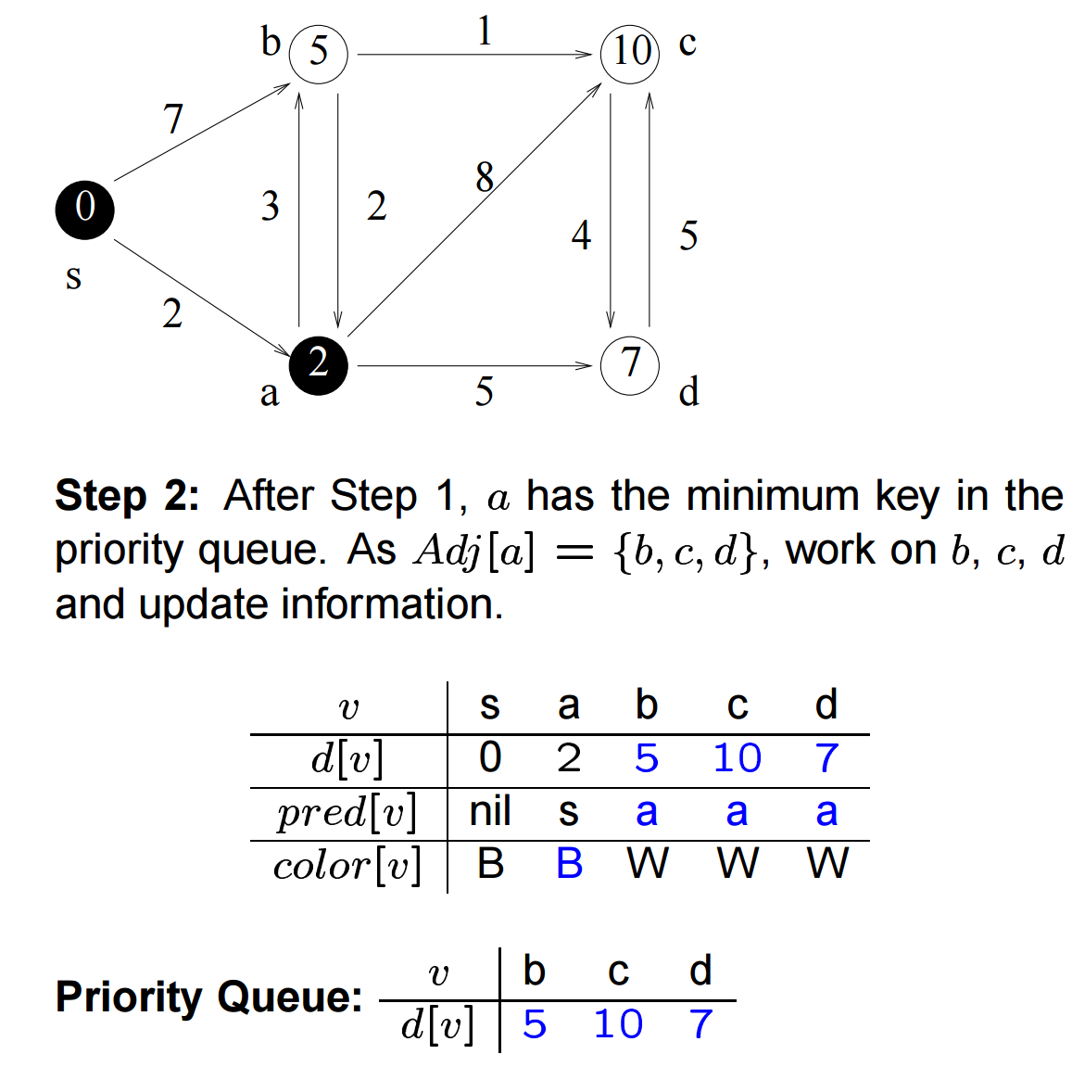
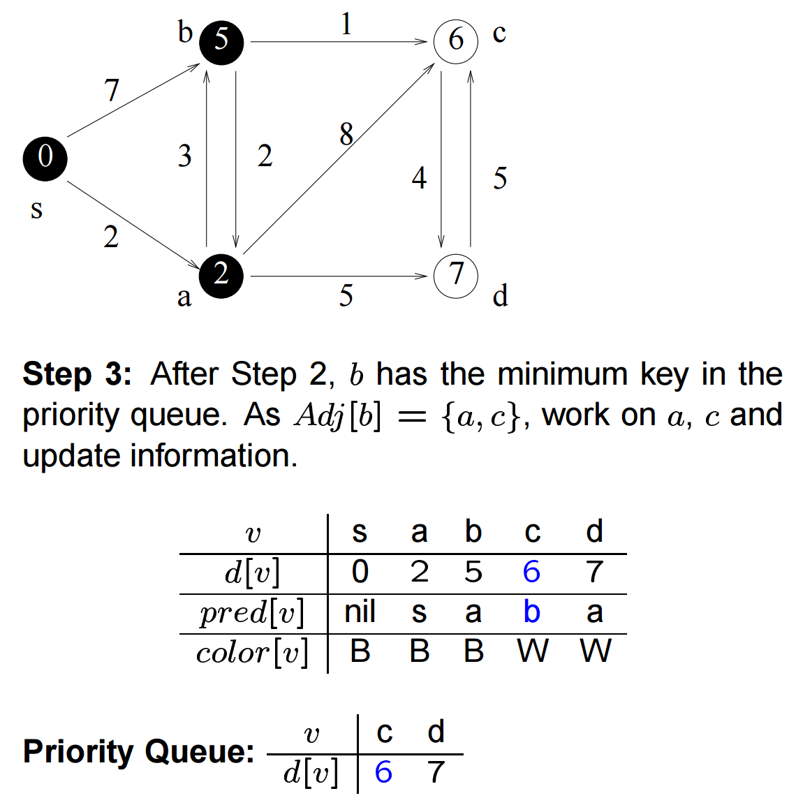
Example 2/3

Slide 52
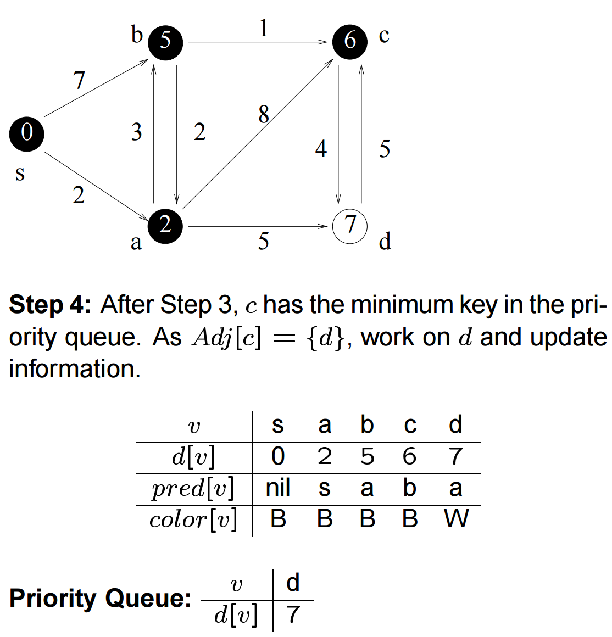
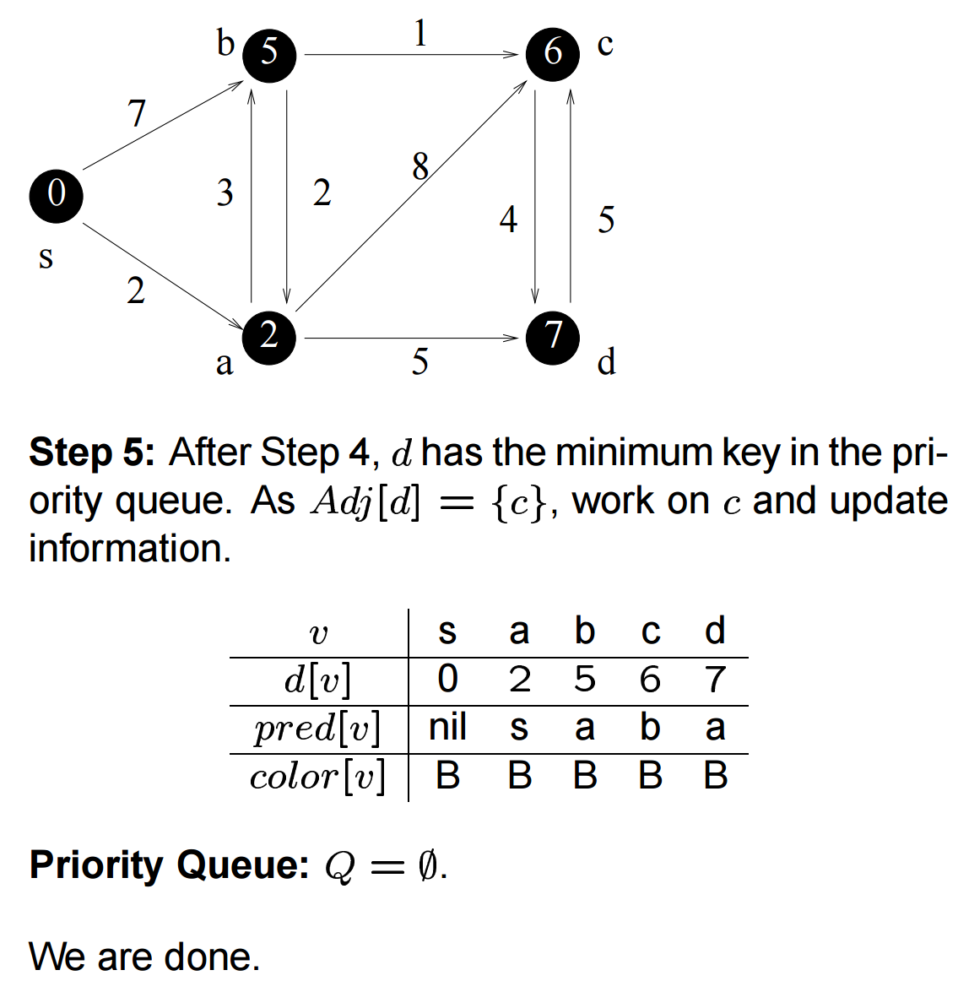
Example 3/3

Slide 53
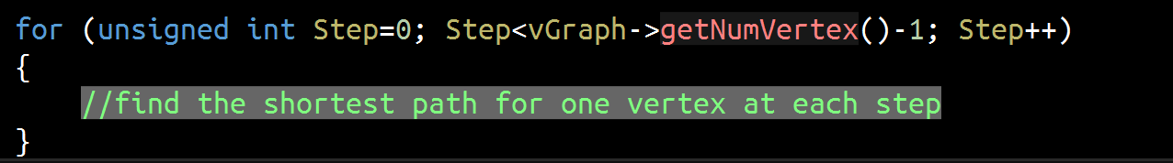
Serial Version 1/4
Algorithm is executed in a FOR loop
In each iteration, one shortest path will be found from some vertex to source vertex
Each iteration contains two steps
Find shortest path and its corresponding vertex v
Update path lengths to source vertex according to v

Slide 54
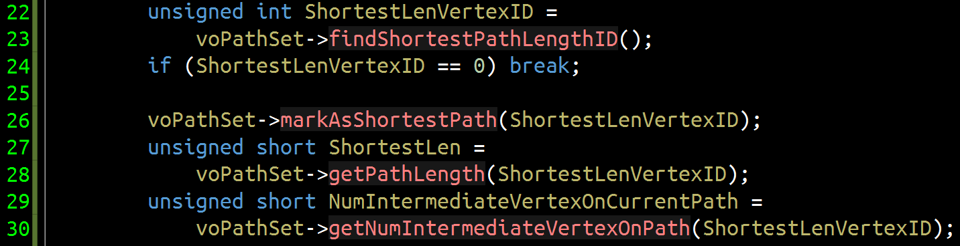
Serial Version 2/4
Find current shortest path
Path from ShortestLenVertexID to source vertex is the current shortest path
Find current shortest path
Mark ShortestLenVertexID to indicate that its shortest path to source vertex has been found

Slide 55
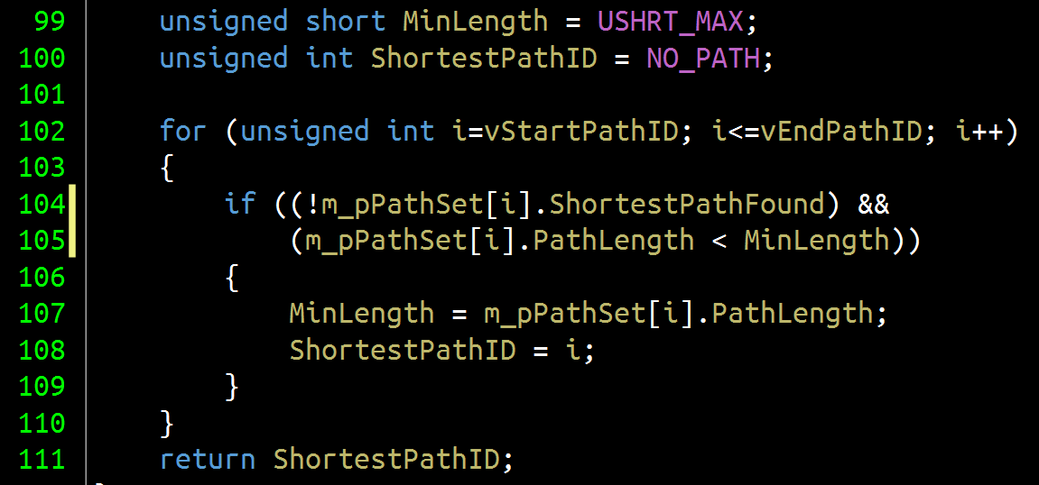
Serial Version 3/4
Details about finding current shortest path

Slide 56
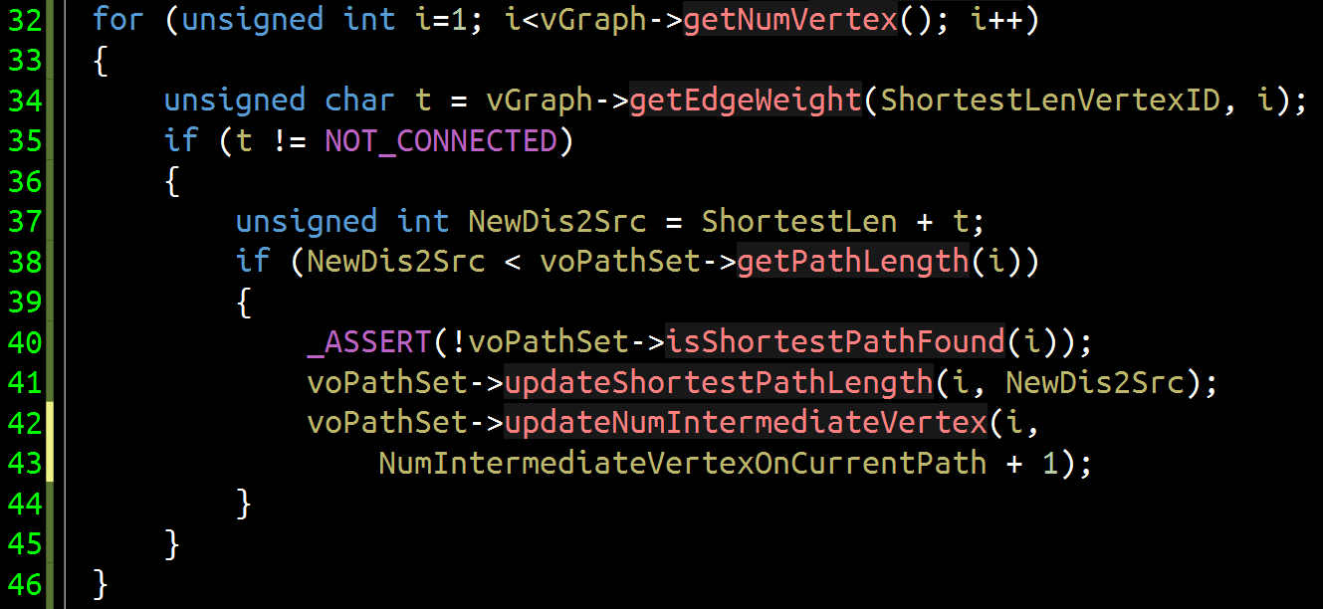
Serial Version 4/4
Update path lengths to source vertex
Compute length of new path from vertex I to source vertex via vertex ShortestLenVertexID
Replace original path with new path if its length is shorter

Slide 57
Analysis on Parallelism 1/3
Check data dependency of all FOR loops in serial version
First loop
Iteration i depends on iteration i-1

Slide 58
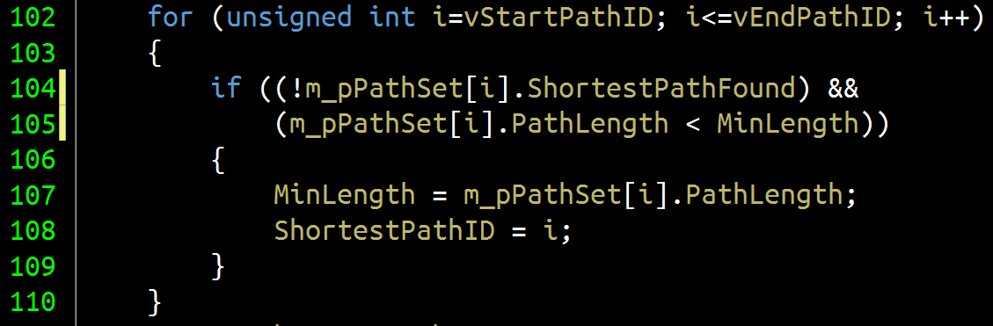
Analysis on Parallelism 2/3
Second loop: find shortest path
All iterations may write the same variables MinLength and ShortestPathID, indicating output dependency

Slide 59
Analysis on Parallelism 3/3
Third loop: update path lengths
Iteration i only updates information of path i

Slide 60
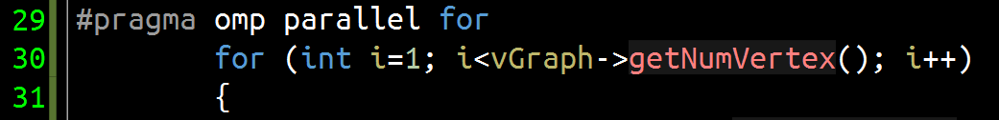
OpenMP Solution I
Observations
First and second loop contain data dependency
Third loop contains no data dependency, thus it can be executed in parallel
Solution
Use OpenMP to accelerate third loop
OpenMP will automatically do data decomposition in this solution
Using this OpenMP directive to accelerate execution of FOR loop

Slide 61
OpenMP Solution II
In this solution, more parallelism will be exploited
Take a further look at the second loop
If MinLength and ShortestPathID is only visible to current thread, data dependency will be removed
How to make variables to be “local” with respect to current thread
How to guarantee correct results

Slide 62
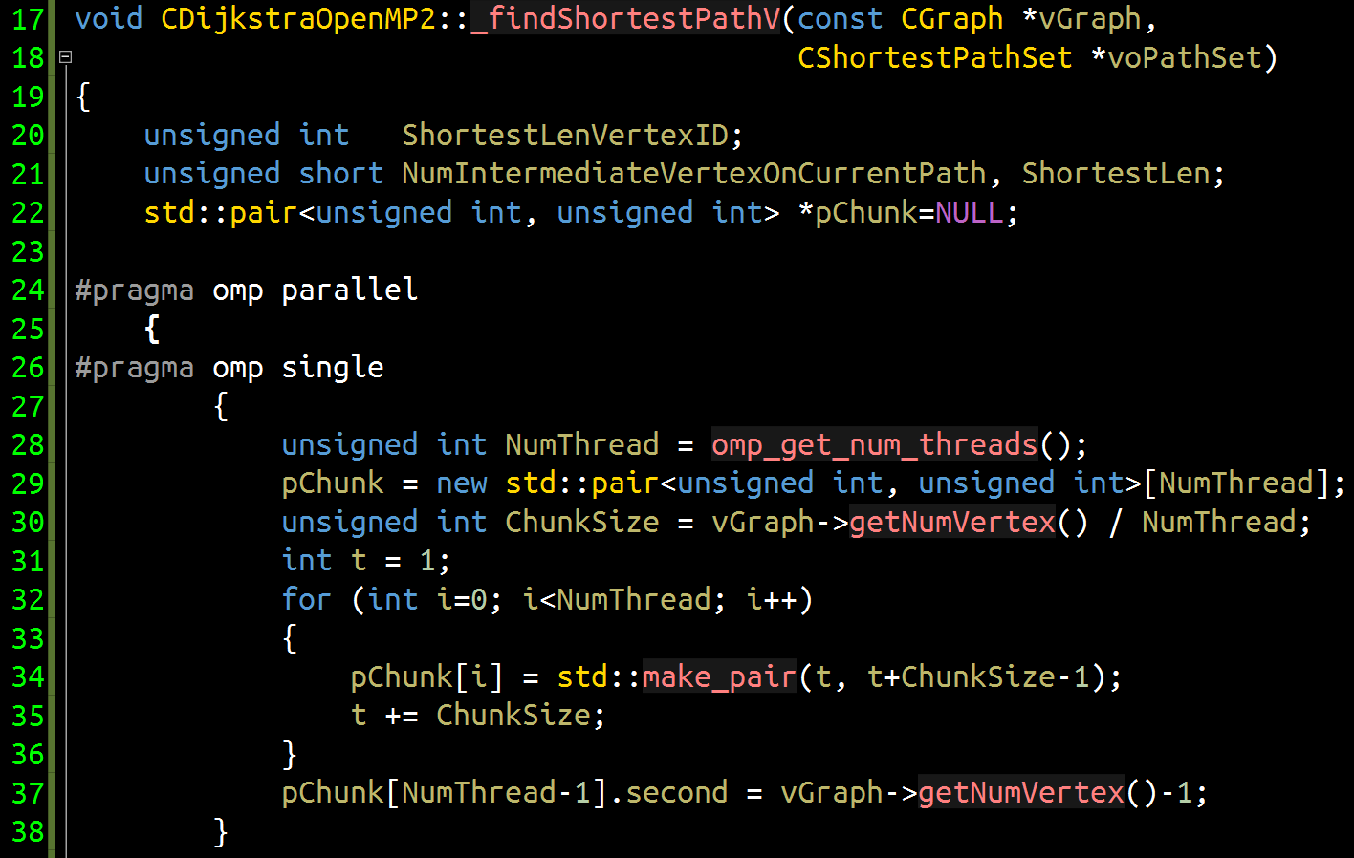
OpenMP Solution II
This block is used to partition data. Thus we only need one thread to execute it
This directive sets up a team of threads, all of which execute followed block in parallel. Unlike for directive, it requires programmer to partition work!
This variable is employed to store data partition results. Thus it has to be shared by all threads
This directive indicates that we want just one thread to execute followed block, even though it is part of parallel
Variables defined here will be visible to all threads created by OpenMP

Slide 63
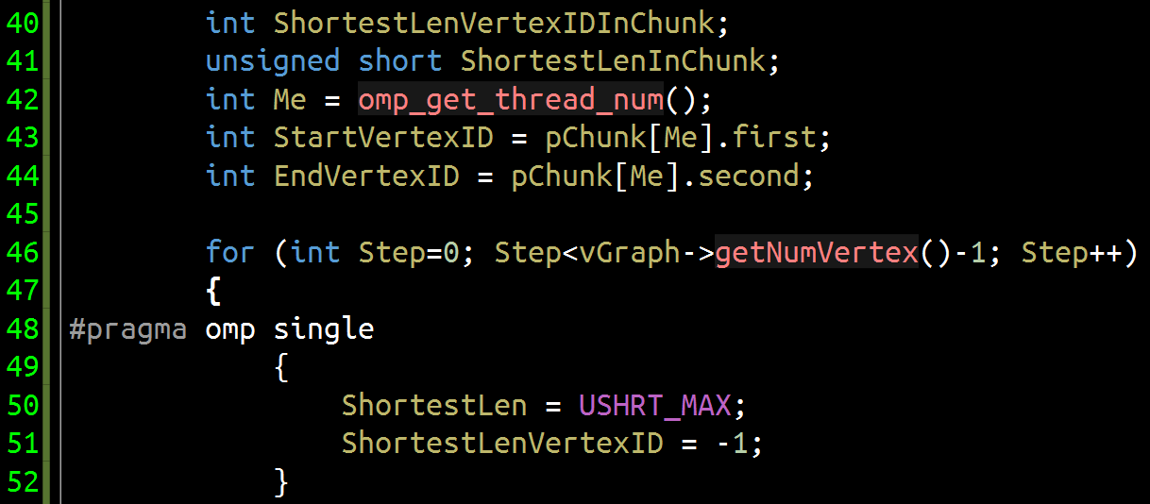
OpenMP Solution II
Determine vertices handled by current thread
Because these variables are defined in the block after directive parallel, they are only visible to current thread
Get thread number of current thread. Thread number in OpenMP will be 0,1,2…
Start executing Dijkstra algorithm in parallel
ShortestLen and ShortestLenVertexID are defined for all vertices, thus they are initialized in a block followed by directive single

Slide 64
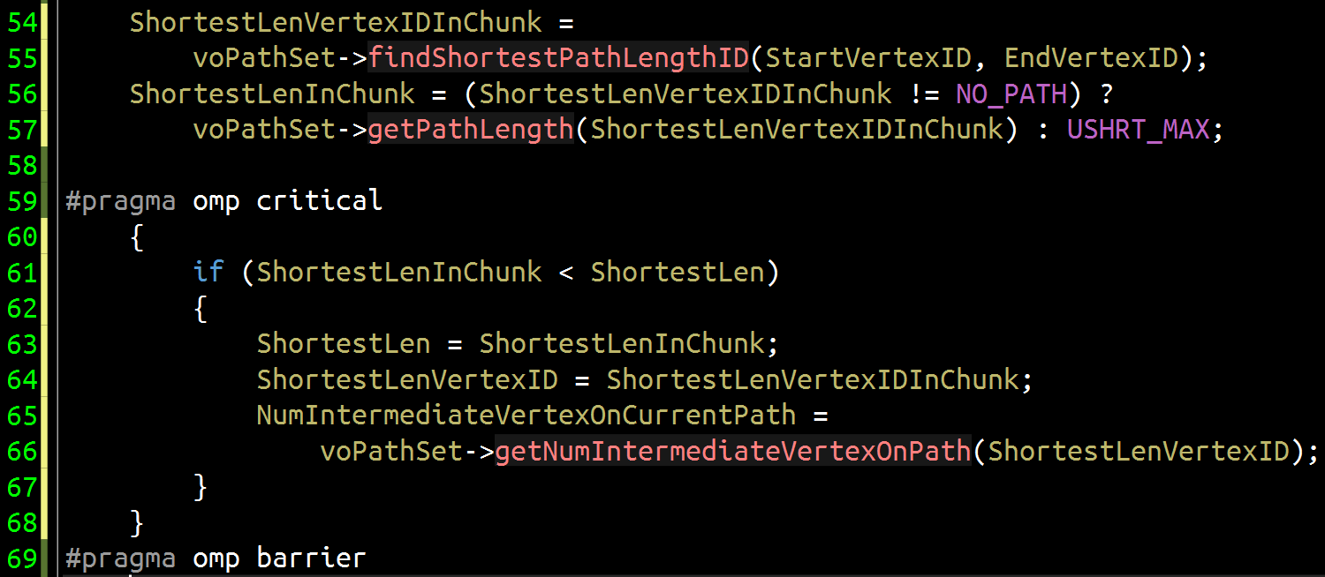
OpenMP Solution II
Because each thread has its own ShortestLenVertexIDInChunk and ShortestLenInChunk, so no data dependency here
This directive allows entry of only one thread at a time while others wait
All threads have to execute this block one by one. Thus after all threads finish work, ShortestLen and ShortestLenVertexID store correct results
Because all threads need ShortestLen and ShortestLenVertexID to continue execution. So this directive is employed here to setup a barrier for all threads

Slide 65
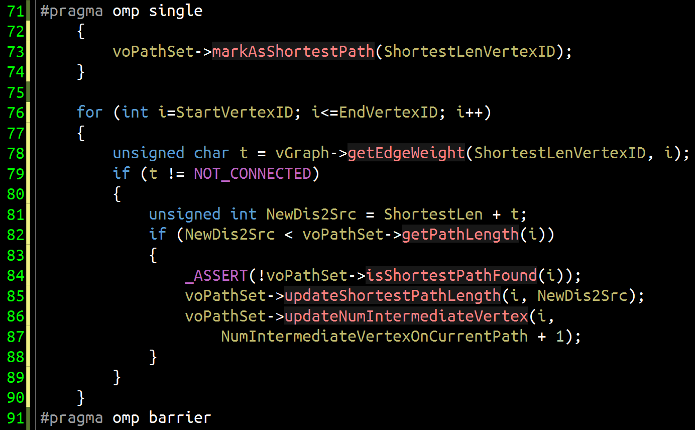
OpenMP Solution II
Again, only one thread is used to mark current shortest path

